Slide 1
Database Systems
Lab 08
XML and it’s technologies

Slide 2
XML
Extensible Markup Language.
XML was designed to store, transport and exchange data.
XML was designed to be both human- and machine-readable.
XML is Software-independent format for exchanging data

Slide 3
Comparison of XML with other Markup Languages
XML | HTML
Extensible Markup Language | Hypertext Markup language
It is use to exchange data or structure data | It is used to structure a webpage
XML uses user defined tags ( we will see this is later example ) | HTML tags are predefined
XML tags are case sensitive | HTML tags are case insensitive
XML tags must be closed, otherwise error | HTML tags should also be closed, but browser won’t mind.
XML is a strict language | HTML is not a strict language

Slide 4
XML Tools
Kernow 1.8
Altova Spy
Dreamweaver
Visual Studio
And much more
We will be using Aptana Studio 3

Slide 5
Let’s Start with XML
XML Example – XML Declaration
<?xml version = “1.0” encoding = “UTF-8”?>
Explanation Of declaration:
XML declaration is also called the PROLOG.
<? = start
?> = end
Why 1.0? Because it’s more popular.
Encoding means we can store international characters.

Slide 6
Root Element and XML Elements
<?xml version = “1.0” encoding = “UTF-8”?>
<email>
<message>
<to> Shoaib.raza@nu.edu.pk </to>
<from> Uzair@nu.edu.pk </from>
<subject> How are you? </subject>
<body> Hi, let’s catch up sometime </body>
</message>
</email>
Here, <email> </email> are termed as root elements.
Apart from root elements, everything termed as Childs.

Slide 7
XML Rules – Guidelines for Naming Tags
XML tags are named by the author
Tags should be meaningful. E.g. <name> instead of <first_tag> or <N>
Tags should not be too log. E.g. <age> instead of <the_current_age_of_the_customer>
The opening and closing tags must have the same case. E.g. <occupation></occupation> instead of <occupation></Occupation>
Never start the element with xml, Xml, XML etc.

Slide 8
XML Rules – Correct Nesting
Each XML element must be correctly nested.
Example:
Incorrect
<member>
<name> Basit </member>
</name>
Correct
<member>
<name> Basit </name>
</member>

Slide 9
XML – Complete Example
<?xml version="1.0" encoding="UTF-8"?> <breakfast_menu> <food> <name>Belgian Waffles</name> <price>$5.95</price> <description> Two of our famous Belgian Waffles with plenty of real maple syrup </description> <calories>650</calories> </food> <food> <name>Strawberry Belgian Waffles</name> <price>$7.95</price> <description> Light Belgian waffles covered with strawberries and whipped cream </description> <calories>900</calories> </food> <food> <name>Berry-Berry Belgian Waffles</name> <price>$8.95</price> <description> Belgian waffles covered with assorted fresh berries and whipped cream </description> <calories>900</calories> </food> <food> <name>French Toast</name> <price>$4.50</price> <description> Thick slices made from our homemade sourdough bread </description> <calories>600</calories> </food> <food> <name>Homestyle Breakfast</name> <price>$6.95</price> <description> Two eggs, bacon or sausage, toast, and our ever-popular hash browns </description> <calories>950</calories> </food> </breakfast_menu>

Slide 10
XML Related Technologies
Xpath: eXtensible path language
DTD: Document Type Definitions
XML Schema
Xquery

Slide 11
What is Xpath?
W3C standard for accessing data in XML
Fundamental part of XLST, Xquery and others
Defines a “Path” into an XML document.

Slide 12
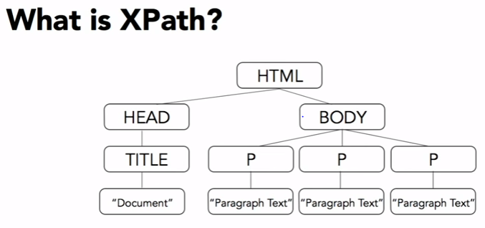
Title? /HTML/HEAD/TITLE P? /HTML/BODY/P *Note: That will give us all three P’s.. First P? /HTML/BODY/P[1] *2nd P? --- P[2] …. 3rd P? --- P[3]

Slide 13
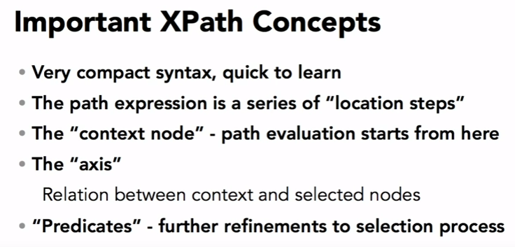

Slide 14
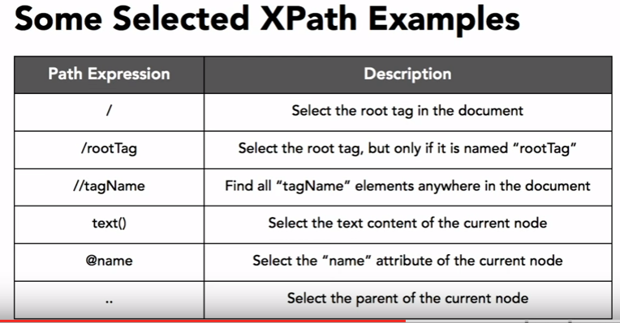

Slide 15
Xpath – Some Examples in Aptana Studio 3
/
/BusinessCard
/BusinessCard/Name
/BusinessCard/Name/text()
/BusinessCard/phone
/BusinessCard/phone[3]
/BusinessCard/phone[2]
/BusinessCard/phone[last()]
//phone
//Name[contains(text(),'Joe')]
//phone[@type]
//phone[@type='work']

Slide 16
DTD
Provide way to constrain XML document content
Specify what type of content can appear and where
Can be included in XML file, or be external to document
Relatively simpler to write, but not powerful

Slide 17
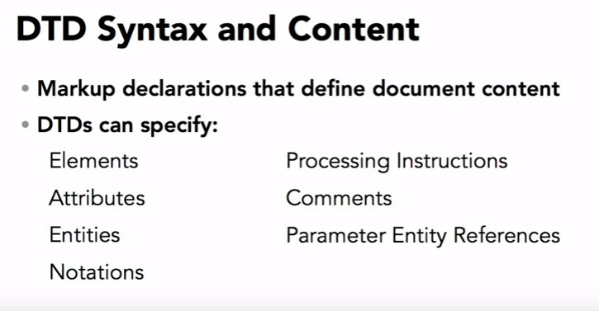

Slide 18
XML Attributes
XML elements can have attributes, just like HTML.
Attributes are designed to contain data related to a specific element.
Attribute values must always be quoted. Either single or double quotes can be used.
For a person's gender, the <person> element can be written like this:
<person gender="female">
Or like this
<person gender='female'>

Slide 19
XML Attributes for Metadata
Sometimes ID references are assigned to elements. These IDs can be used to identify XML elements in much the same way as the id attribute in HTML.
This example demonstrates this:
<messages> <note id="501"> <to>Tove</to> <from>Jani</from> <heading>Reminder</heading> <body>Don't forget me this weekend!</body> </note> <note id="502"> <to>Jani</to> <from>Tove</from> <heading>Re: Reminder</heading> <body>I will not</body> </note> </messages>

Slide 20
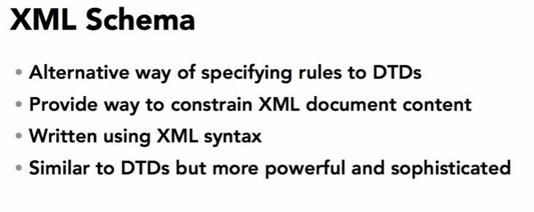

Slide 21
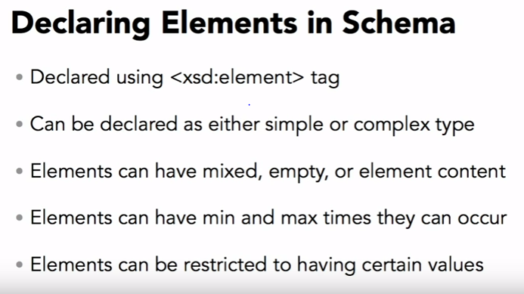

Slide 22
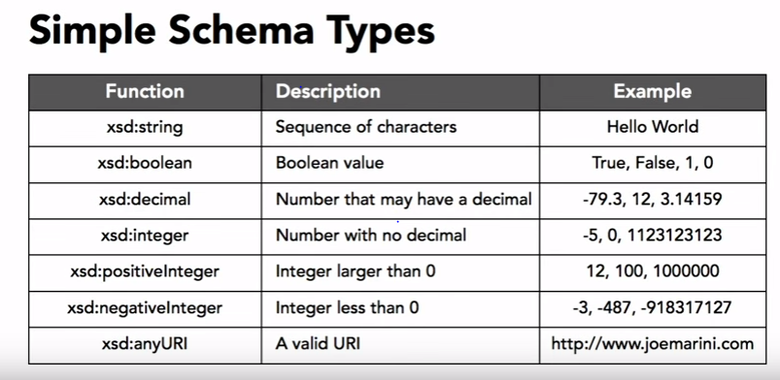

Slide 23
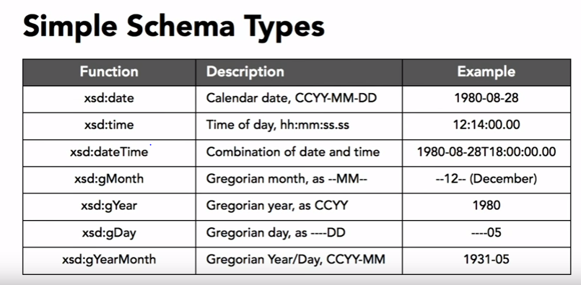

Slide 24
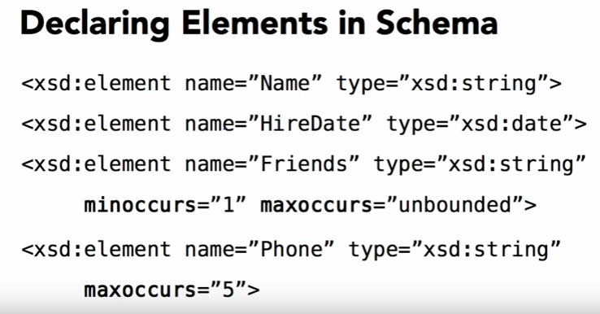

Slide 25
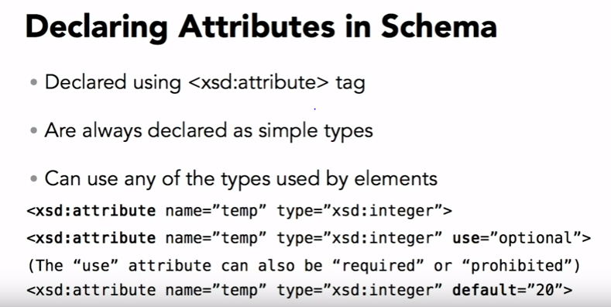

Slide 26
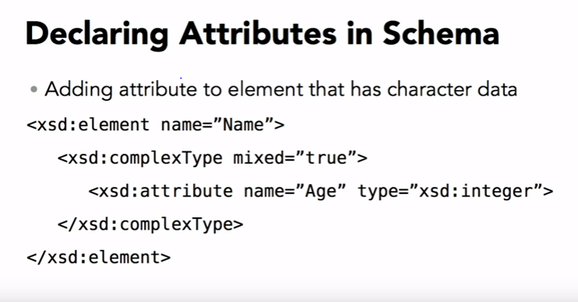

Slide 27
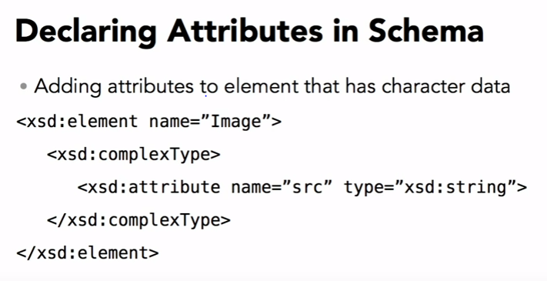

Slide 28
XQuery
XQuery is to XML what SQL is to database tables.
XQuery is designed to query XML data
XQuery Example
for $x in doc("books.xml")/bookstore/book where $x/price>30 order by $x/title return $x/title

Slide 29
Xpath – Some Examples in Aptana Studio 3
Functions:
XQuery uses functions to extract data from XML documents.
The doc() function is used to open the "books.xml" file:
doc("books.xml")
Path Expressions:
XQuery uses path expressions to navigate through elements in an XML document.
The following path expression is used to select all the title elements in the "books.xml" file:
doc("books.xml")/bookstore/book/title

Slide 30
Continue..
Predicates:
XQuery uses predicates to limit the extracted data from XML documents.
The following predicate is used to select all the book elements under the bookstore element that have a price element with a value that is less than 30:
doc("books.xml")/bookstore/book[price<30]

Slide 31
FLWOR
FLWOR (pronounced "flower") is an acronym for "For, Let, Where, Order by, Return".
For - selects a sequence of nodes
Let - binds a sequence to a variable
Where - filters the nodes
Order by - sorts the nodes
Return - what to return (gets evaluated once for every node)

Slide 32
FLWOR
Look at the following path expression:
doc("books.xml")/bookstore/book[price>30]/title
The expression above will select all the title elements under the book elements that are under the bookstore element that have a price element with a value that is higher than 30.
The following FLWOR expression will select exactly the same as the path expression above:
for $x in doc("books.xml")/bookstore/book where $x/price>30 return $x/title

